Slide 1
Forest Fire Prevention System
Parul Institute of Computer Applications
Semester 5 Project – 1
2023-24
Team members
1. 210510126018 Aditya Kumar Pan Div :- F
2. 210510126027 Het Nirav Bhai Shah Div:- F
3. 210510126019 Yavisth Panchal Div :- F

Slide 2
INDEX
Abstract
Tools and Technology Used
Features
Future Enhancements of Proposed System
Limitation of Proposed System
Users and their role description
System Flow Diagram
Data Flow Diagram (All Levels)
Use Case Diagram
Data Dictionary
Screenshot of development Phase 1 (Design)
Screenshot of development Phase 2 (Implementation)

Slide 3
Abstract
Every year forest fires destroy a huge area of forest cover, leaving large-scale destruction of flora and fauna in its wake. Forest fires play a major role in driving thousands of species of wildlife to extinction year. Artificial intelligence helps us predict the future and using it in this domain can successfully help us predict forest fires and save wildlife.
Any fire essentially depends upon 3 factors which are oxygen, temperature, and humidity. This project aims at predicting the possibility of a forest fire taking place, given the oxygen, humidity, and temperature content of a given place. A concept website that can be created to take inputs from the user and predicts the forest fire probability in real-time, is also shown.

Slide 4
Tools and Technology Used
Technology: HTML, CSS, Python, FLASK (A microweb framework that integrates web applications with any python program).
Hardware: Device with basic Operating system such as linux or windows ,Cpu,Gpu and minimum 2GB of storage and memory(RAM)
Software: This software does not require a particular Operating System(Windows, Mac, Linux, etc.) to run but only a web browser and internet connection because it is a web application

Slide 5
Features
User Registration and Authentication: Implement a user registration and authentication system to allow users to create accounts and log in securely.
Weather Data Integration: Integrate with weather APIs or services to fetch real-time weather data for the forest area.

Slide 6
Future Enhancements
Advanced Data Integration: Enhancements can be made to integrate a wider range of data sources. This can provide a more comprehensive and up-to-date picture of fire risks and behavior, enabling more accurate predictions and decision-making.
IoT and Sensor Networks: Integrating IoT devices and sensor networks can provide real-time data on various parameters, such as temperature, humidity, wind speed, and moisture levels. This data can be used to monitor environmental conditions and detect anomalies that may indicate fire risks.
Real-time Monitoring and Control Systems: Integration with real-time monitoring and control systems, such as drones and IoT devices, can enable remote monitoring of fire-prone areas. These systems can provide live feeds, aerial imagery, and situational data, allowing for quick response and more efficient resource deployment.

Slide 7
Limitation of System
Data Accuracy and Availability: The effectiveness of a forest fire prevention system heavily relies on the quality and availability of data. Inaccurate or incomplete data, such as outdated weather information or inaccurate fire risk assessments, can impact the system's ability to make accurate predictions and recommendations. Limited data sources or gaps in data coverage can also hinder the system's capabilities.
Uncertainty in Fire Behavior: Forest fires are dynamic and complex events, and predicting their behavior with absolute certainty is challenging. Fire behavior can be influenced by numerous factors, including topography, vegetation type, wind patterns, and human intervention.

Slide 8
Users and their role description
System Administrators: These individuals are responsible for installing, configuring, and maintaining the forest fire prevention system.
Data Managers: Data managers handle the collection, storage, and organization of the data used in the system. They ensure that the system has access to up-to-date and accurate information about weather conditions, fire hazard levels, temperature, humidity and oxygen level.
Firefighters: Firefighters are the primary end-users of the forest fire prevention system. They rely on the system to receive real-time information about fire incidents, fire behavior, and the optimal strategies for fire suppression.

Slide 9
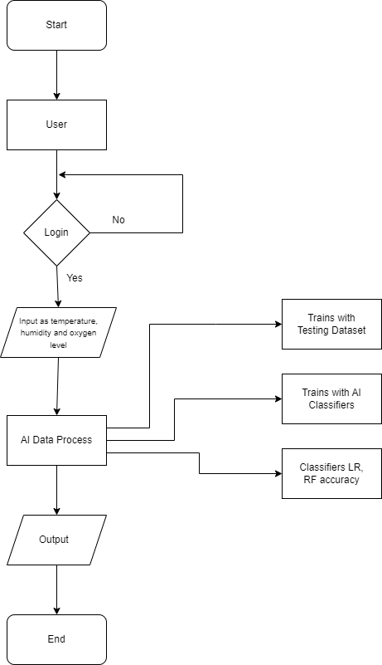
System Flow Diagram

Slide 10
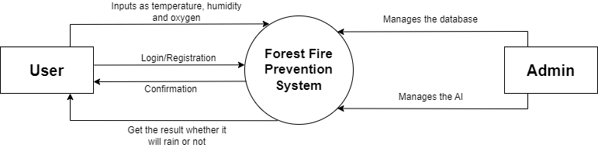
Data Flow Diagram (0 Level)

Slide 11
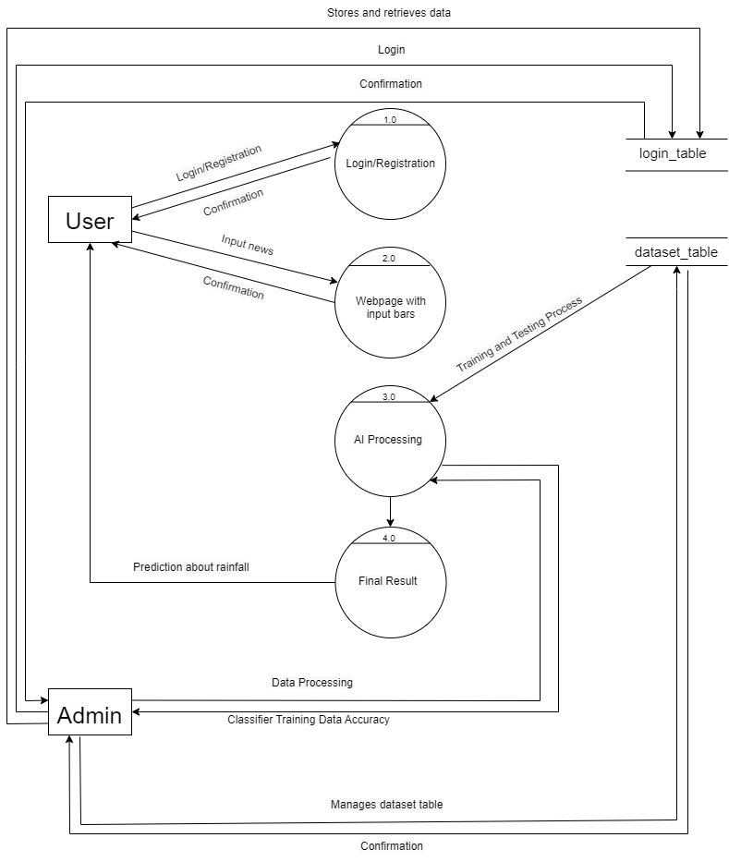
Data Flow Diagram (1 Level)

Slide 12
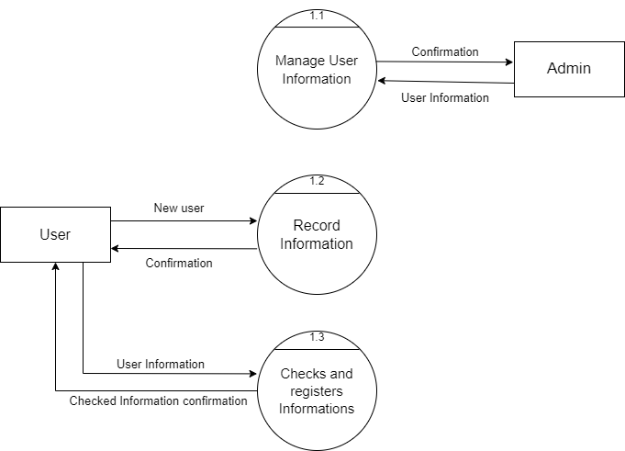
Data Flow Diagram (2 Level)

Slide 13
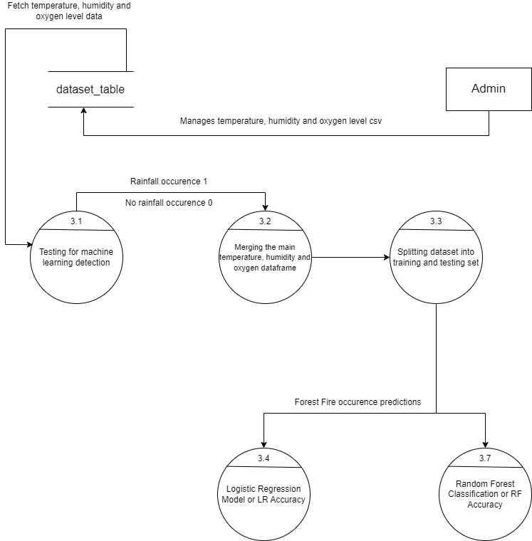
Data Flow Diagram (2 Level)

Slide 14
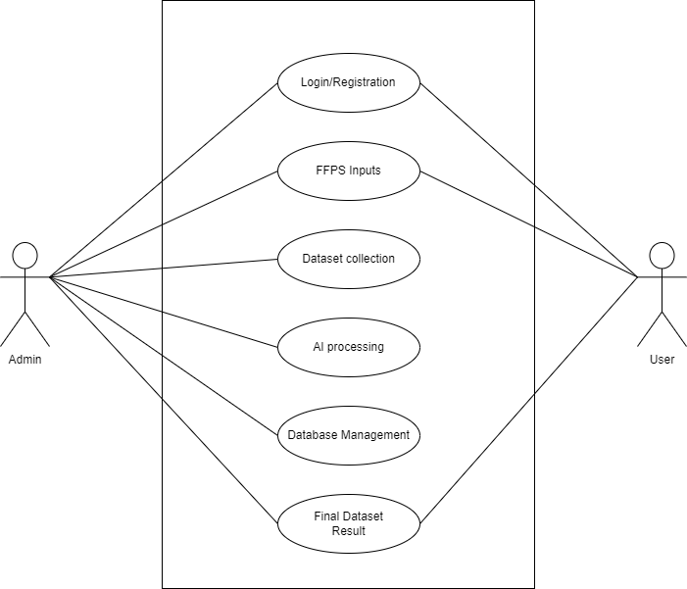
Use Case Diagram

Slide 15
Data Dictionary
Users:
Table Description: Registration
Sr. No | Field Name | Datatype | Size | Description | Constraint | Example
1 | name | varchar | 256 | Name of the User | NOT NULL | Aditya Kumar Pan
2 | username | varchar | 256 | Username of the User | NOT NULL | aditya123
3 | email | varchar | 50 | E-mail of the User | NOT NULL | aditya123@gmail.com
4 | password | varchar | 8 | Password of the User | NOT NULL | aditya12

Slide 16
Data Dictinary
Users:
Table Description: Login
Sr. No | Field Name | Datatype | Size | Description | Constraint | Example
1 | email | varchar | 50 | E-mail of the User | NOT NULL | aditya123@gmail.com
2 | password | varchar | 8 | Password of the User | NOT NULL | aditya12

Slide 17
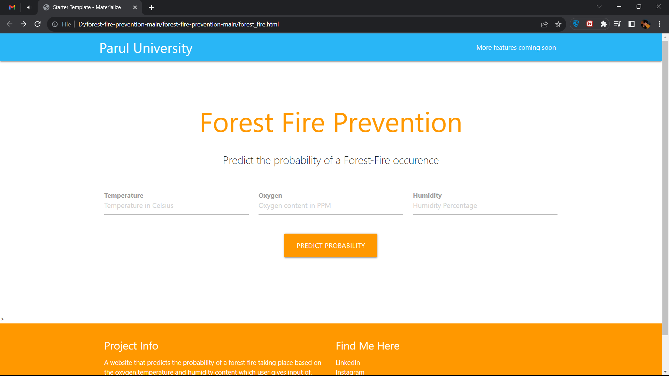
Screenshot of Development Phase -1 (Design)

Slide 18
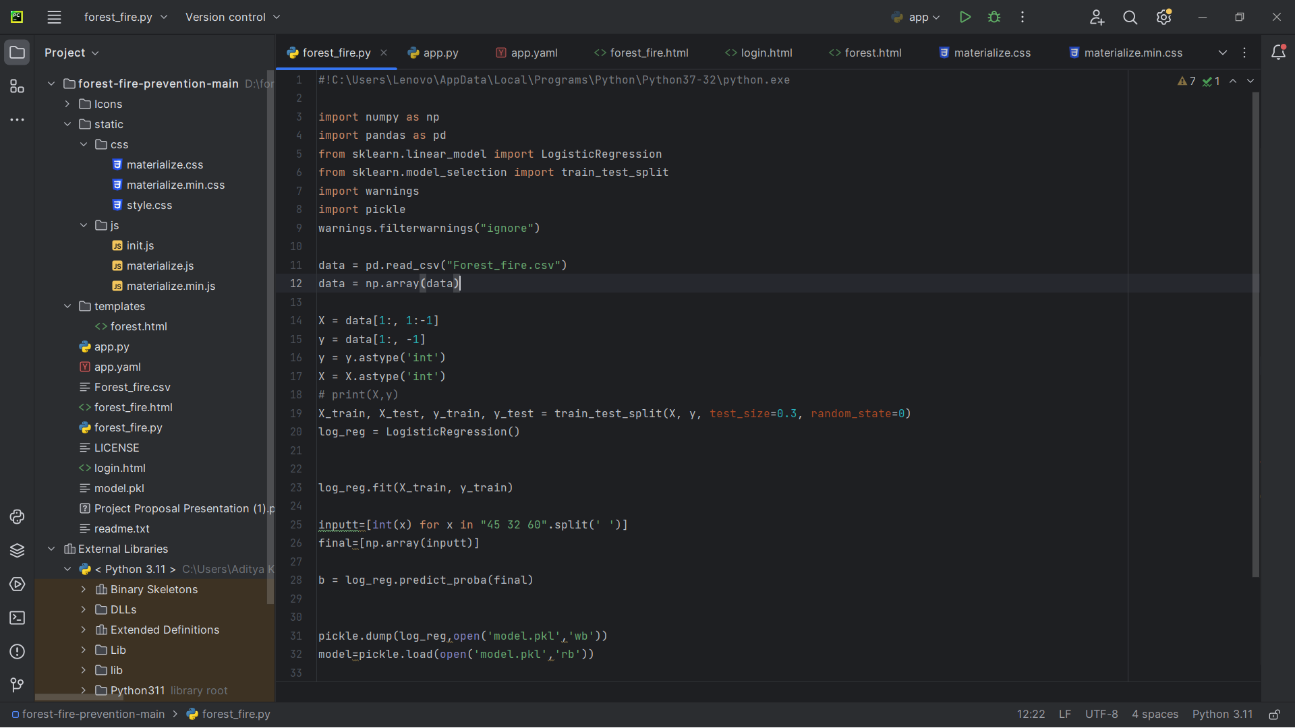
Screenshot of Development Phase -1 (Implementation)

Slide 19
Thank you !!!

